Slide 1

Logistics Optimization - Flipkart
Flipkart, one of India’s largest e-commerce giants, delivers millions of orders every day across metros, Tier-2, and Tier-3 cities through its logistics arm, Ekart Logistics. The logistics network includes regional fulfillment centers, sorting hubs, and last-mile delivery partners across India. As order volumes rise - especially during sales and festive seasons - delays, route inefficiencies, and traffic disruptions can significantly affect both customer satisfaction and operational costs.

Slide 2

Project Overview:
Objective: Build a SQL-driven analytics system to analyze delivery delays, optimize routes, and enhance shipment efficiency.
Data Sources: Orders, Routes, Warehouses, Delivery Agents, and Shipment Tracking tables.
Project Objective: Build a SQL-driven Logistics analytics system to analyze delays, optimize routes, and enhance shipment efficiency by leveraging queries, aggregations. The project aims to answer key business questions, uncover inefficiencies, and recommend actionable improvements based on data analysis.

Slide 3
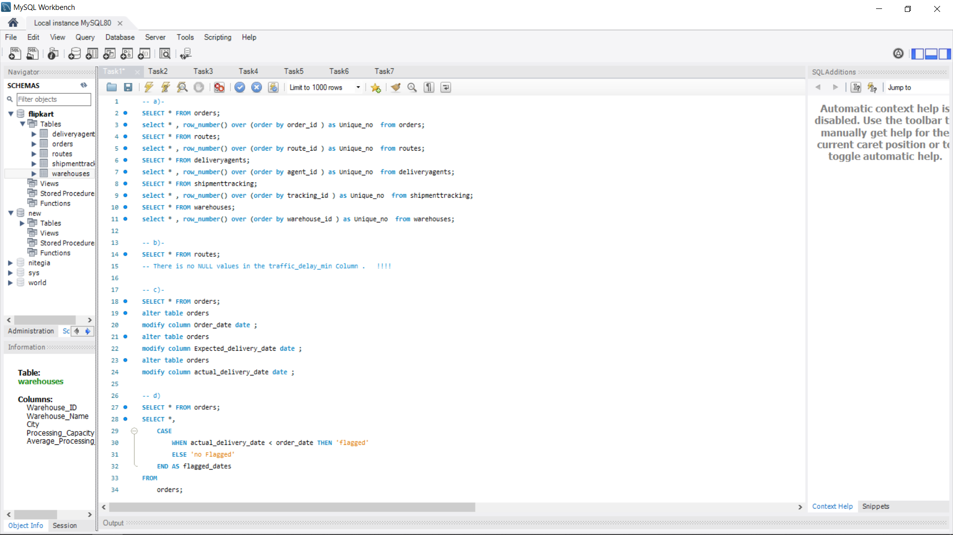
Task 1 – Data Cleaning & Preparation https://drive.google.com/file/d/1EdAZAxc5mcZyI3q8VLMmC3wwZrjcw5_8/view?usp=drive_link

Slide 4
Task 1 outputs
a)-
b)-
c)-
d)-

Slide 5
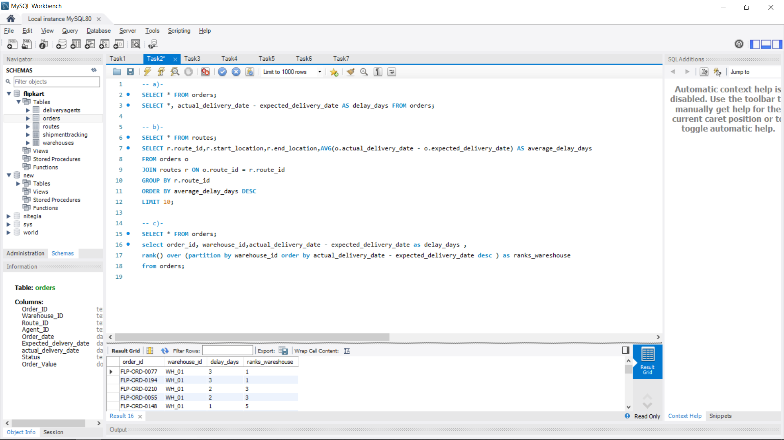
Task 2 – Delivery Delay Analysis https://drive.google.com/file/d/1gjg1lAG-sVOfa4PmX2yAJhFDNd9e4VB5/view?usp=drive_link

Slide 6
Task 2 outputs
a)-
b)-
c)-

Slide 7
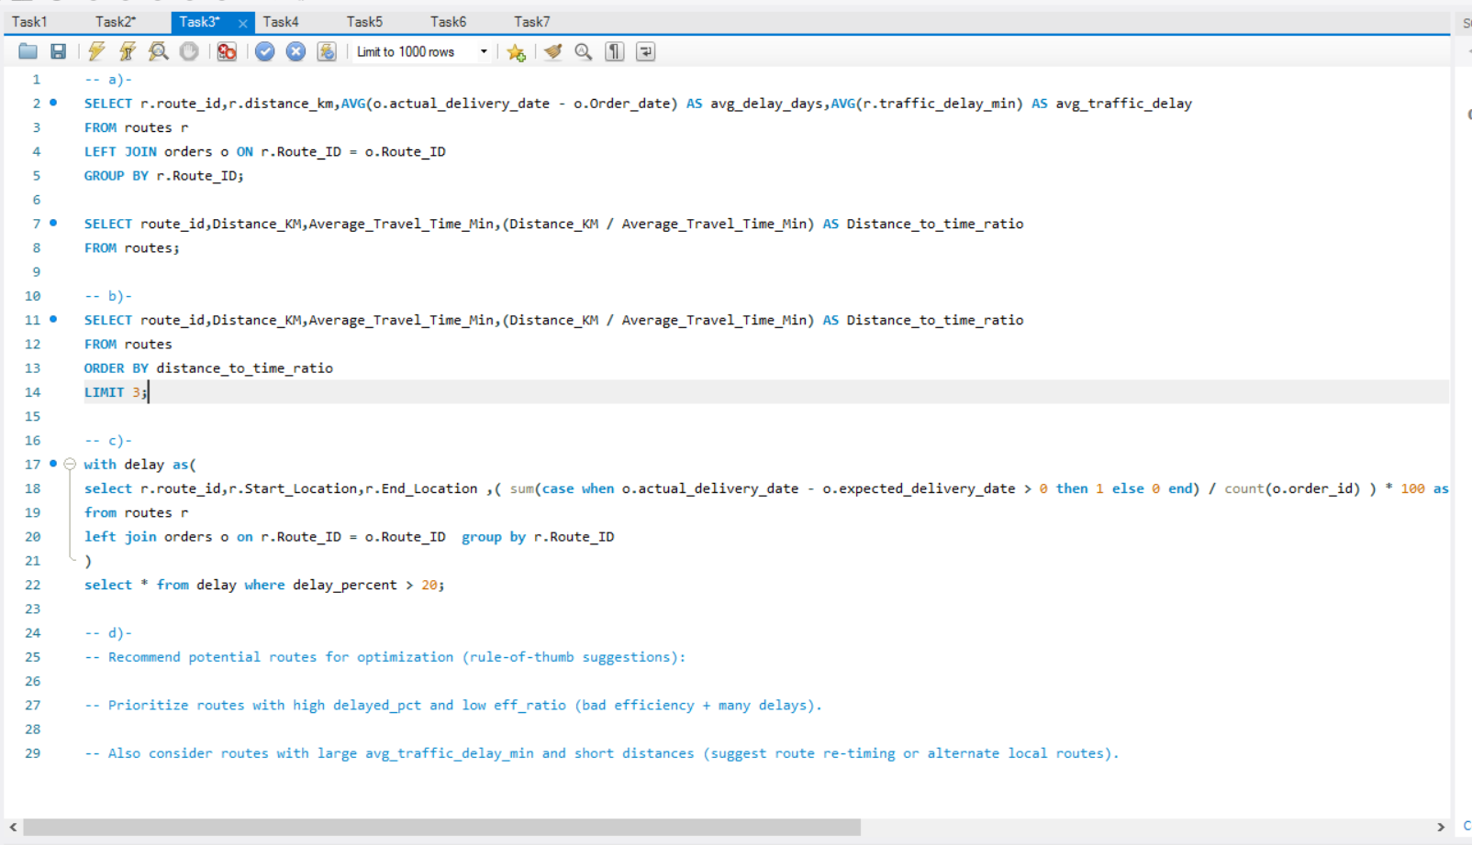
Task 3 – Route Optimization Insights https://drive.google.com/file/d/1cUIO5Kh4qr0TEucqmyLrzvS7HAE_4SrD/view?usp=drive_link

Slide 8
Task 3 outputs
a)-
a)-
b)-
c)-

Slide 9
Task 3 d)-Recommendation
Routes with high delayed time and low efficiency ratio (bad efficiency + many delays).
Routes with large Traffic Delay and short distances (suggest alternate local routes).

Slide 10
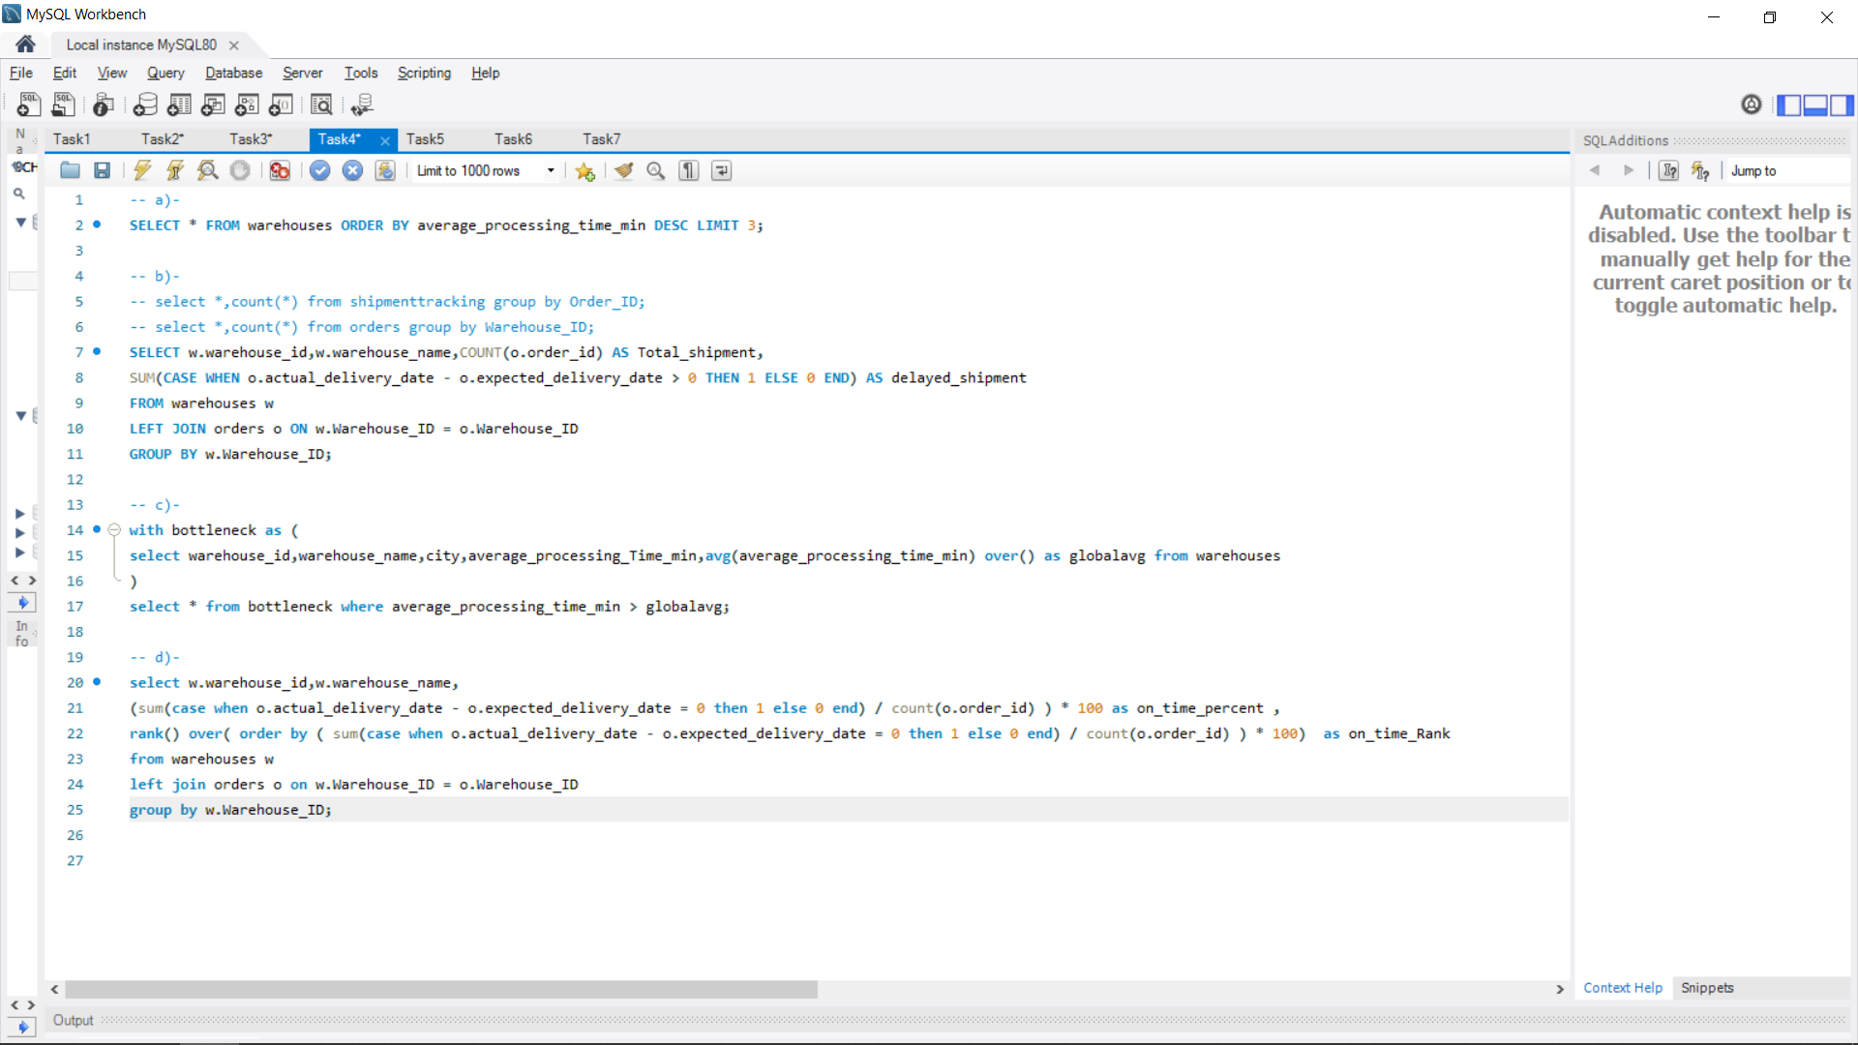
Task 4 – Warehouse Performance https://drive.google.com/file/d/1hS87rXZL9GCQQ81SjB2OZjcTvHugMX4s/view?usp=drive_link

Slide 11
Task 4 outputs
a)-
b)-
c)-
d)-

Slide 12
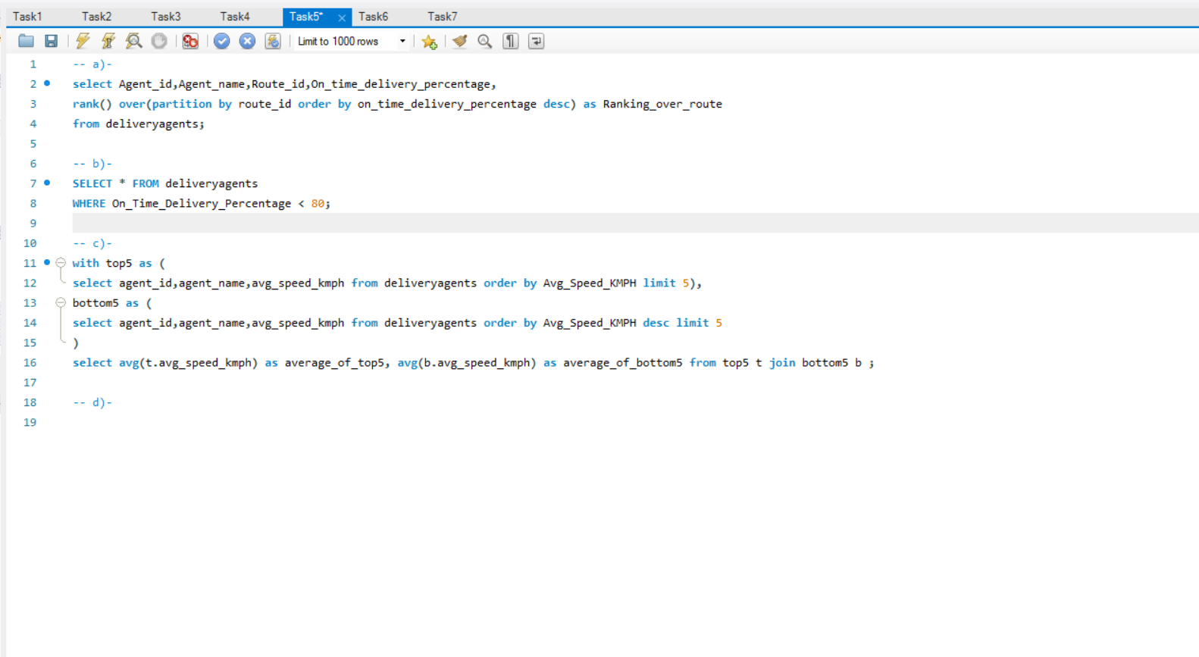
Task 5 – Delivery Agent Performance https://drive.google.com/file/d/1-SyvNeyOVMvBmOrjdZh6TjqKz3RjEzh_/view?usp=drive_link

Slide 13
Task 5 outputs
a)-
b)-
c)-

Slide 14
Task 5 d) Recommendations
Focused Training: Offer targeted sessions on navigation, time management, and traffic handling.
Workload Balancing: Limit excessive daily deliveries and rotate routes to reduce fatigue.
Incentive Programs: Reward agents who show measurable improvement in on-time performance.
Technology Support: Provide real-time tracking and performance dashboards for feedback.

Slide 15
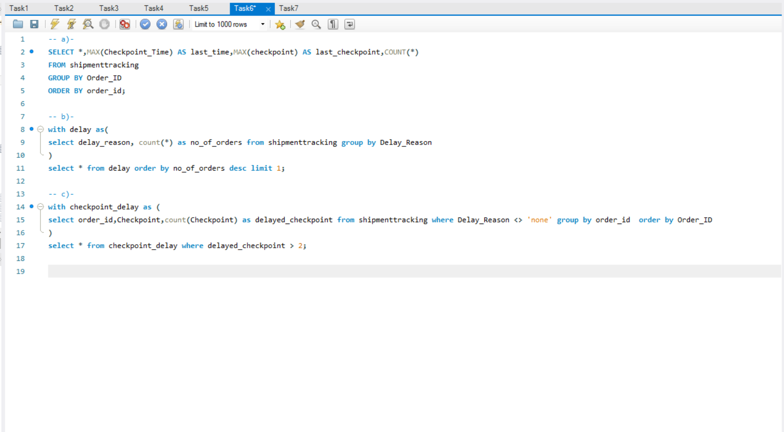
Task 6 – Shipment Tracking Analytics https://drive.google.com/file/d/1VSpvrKrFXE6BXI_ZtTvPlqjDoYgnj0qT/view?usp=drive_link

Slide 16
Task 6 outputs
a)-
b)-
c)-

Slide 17
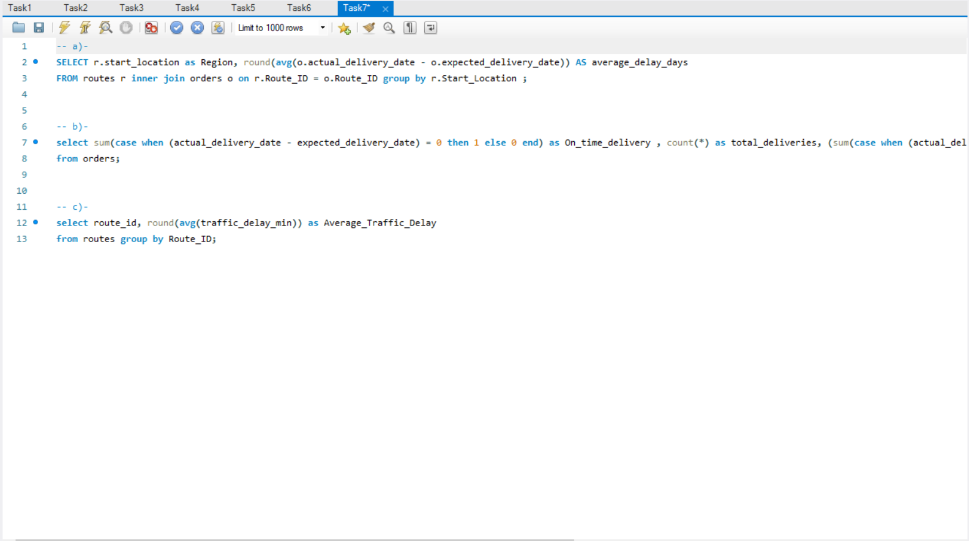
Task 7 – Advanced KPI Reporting https://drive.google.com/file/d/1vbnSpCxnfzpSrJcuZ_TSXS4vNldVxDbk/view?usp=drive_link

Slide 18
Task 7 outputs
a)-
b)-
c)-

Slide 19
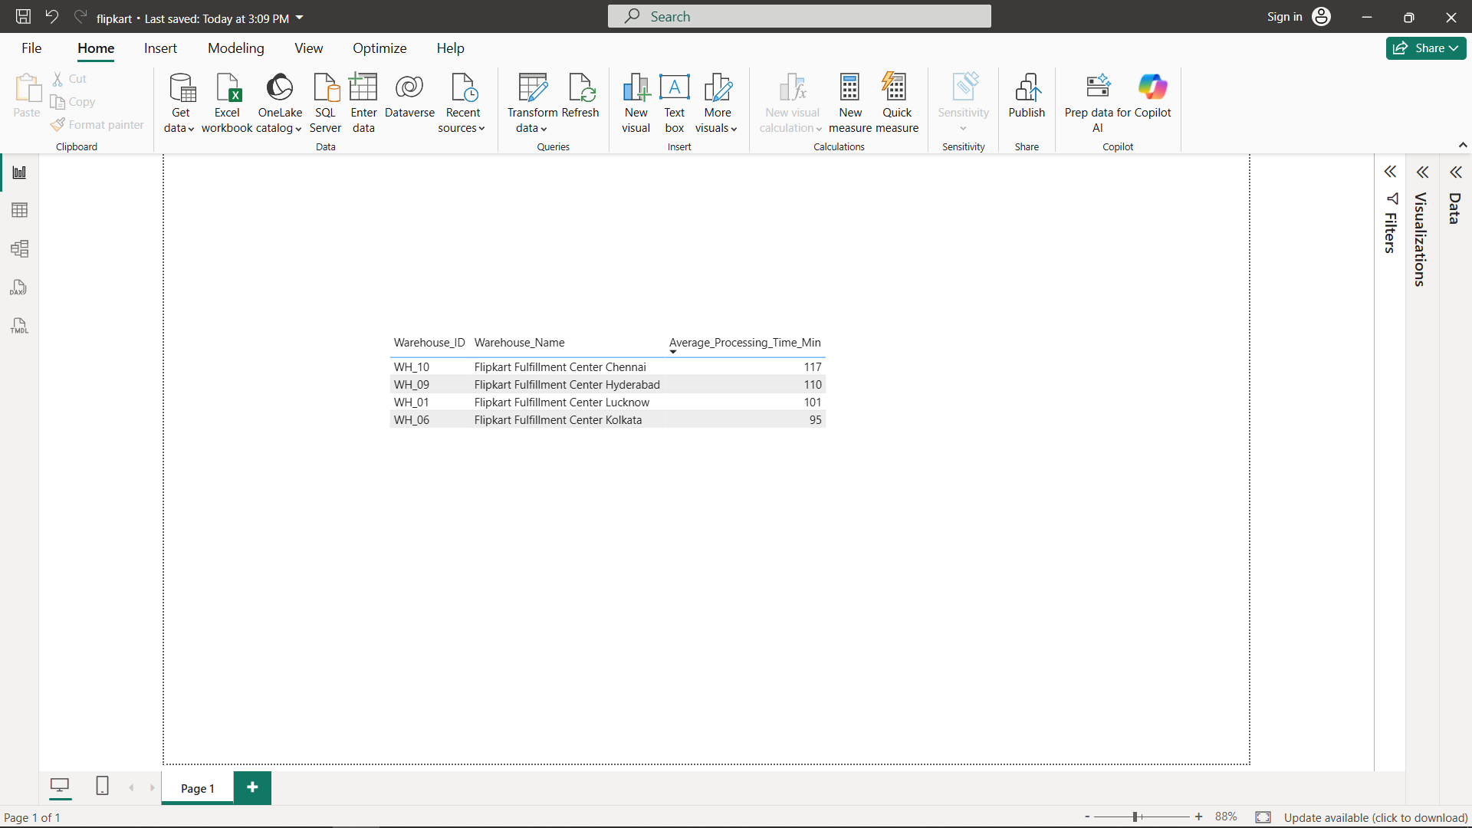
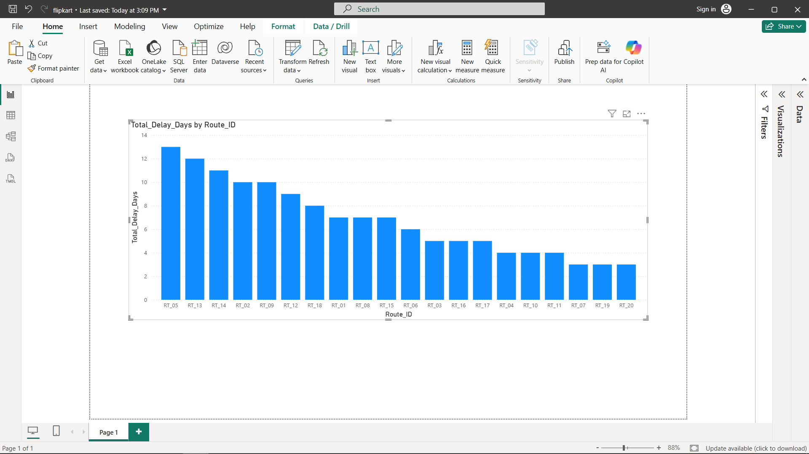
Task 8 – Summary & Recommendations
Top delayed routes and inefficient warehouses identified.
Routes with high delayed time and low efficiency ratio (bad efficiency + many delays).
Routes with large Traffic Delay and short distances (suggest alternate local routes).

Slide 20
Task 9 – Video Submission
https://www.loom.com/share/6291daf25a3c4b25b3e9e3d6c4a63df7

Slide 21
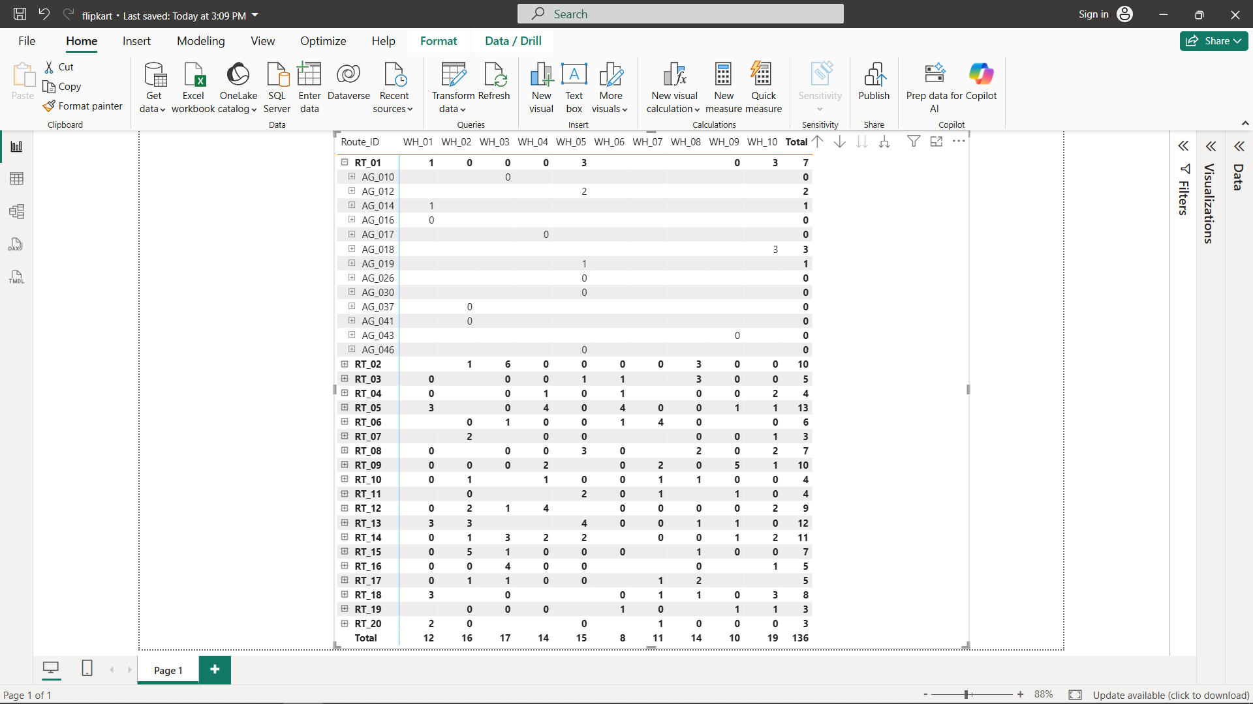
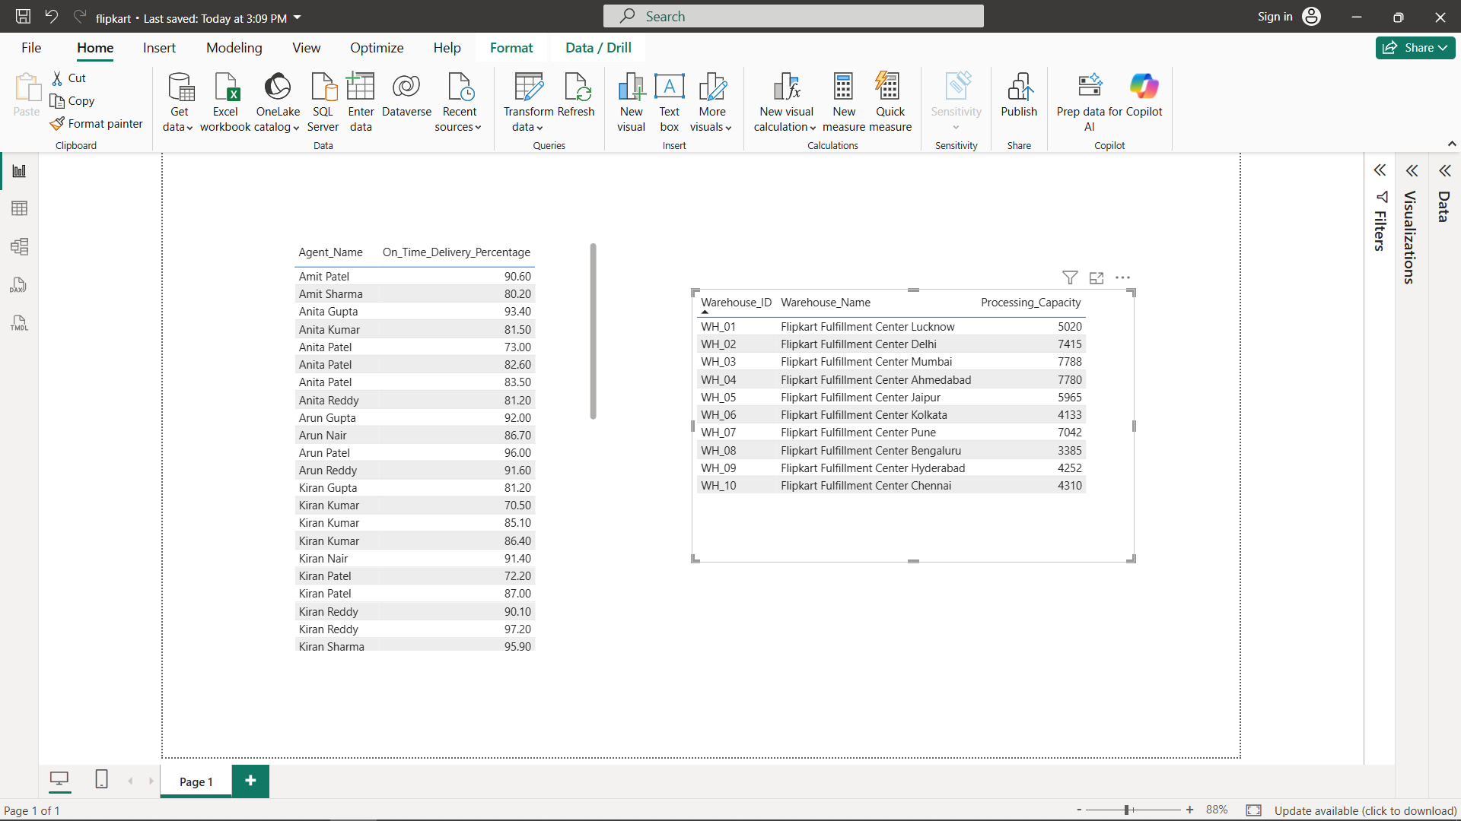
Final Insights
Agents’s Efficiency on the basis of On_Time_delivery

Slide 22
Conclusion & Recommendations
Data-driven decision making in logistics operations is made possible by SQL-driven analytics. Regular KPI tracking increases agent productivity and route efficiency.
This analysis supports Flipkart’s aim for faster and more cost-efficient deliveries.

